Slide 1
Poker-AI
Student name: Lee Murray
Date of the Presentation: 06/12/2017

Slide 2
Introduction
Project Context
Target Customer
Problem Approach
Opportunities & Limits
Goals
System/Description/Design
Evaluation
Demonstration
Feedback

Slide 3
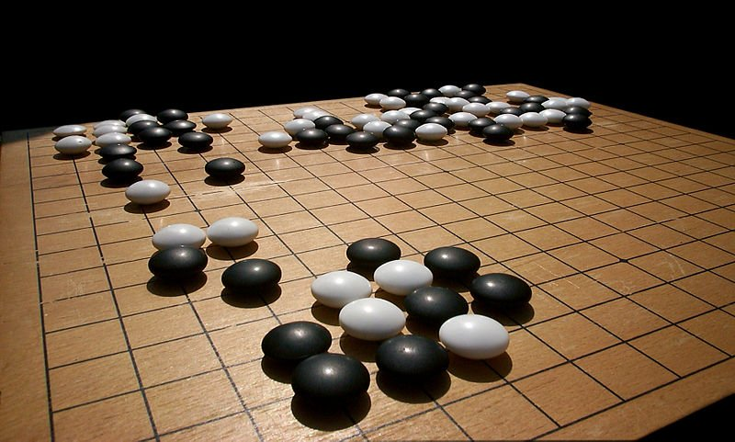
Project Context
Games Theory and AI in Game Theory
2016 – AlphaGo d vs Lee Sedol.

Slide 4

Project Context
2007 - Jonathan Schaeffer Solves Checkers

Slide 5
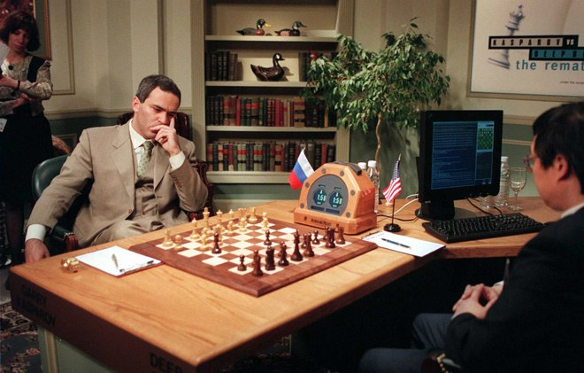
Project Context
1997 – Deep Blue VS Kasparov
Turning Point in AI

Slide 6

Project Context
Colours Effects of actions
Numbers Short-Term Planning
Pattern Matching Long-Term Planning
Strategic Thinking Cooperation
Problem Solving Social Skills

Slide 7

Project Context
Colours Effects of actions
Numbers Short-Term Planning
Pattern Matching Long-Term Planning
Strategic Thinking Cooperation
Problem Solving Social Skills

Slide 8
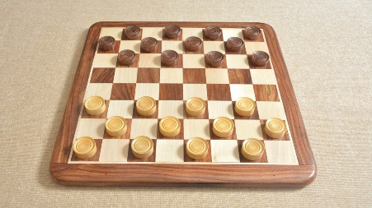
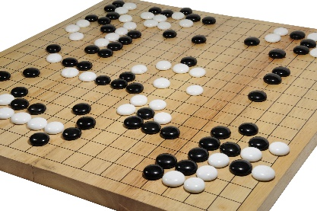
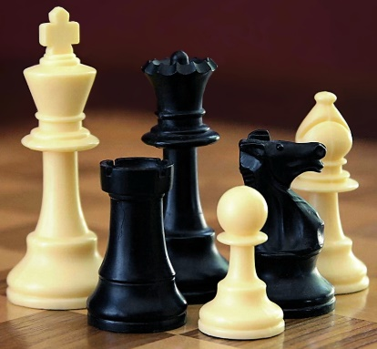
Project Context
Perfect Information Games
All information needed is given

Slide 9
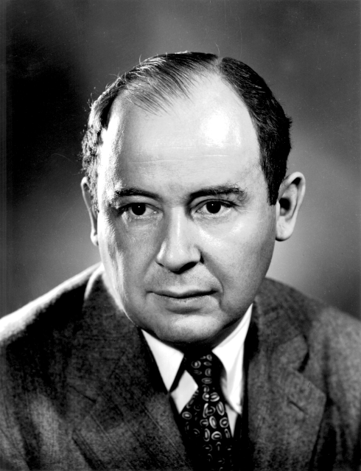
Project Context
Real life is not like chess. Real life consists of bluffing, of little tactics of deception, of asking yourself what the other player is going to think I mean to do. And that is what games are about in my theory.
Von Neumann from a discussion
Recounted by Bronokowski (1973)

Slide 10
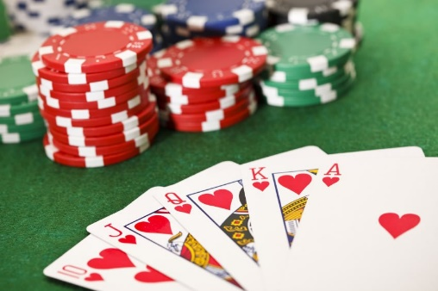
Poker
Limit
Bet
Raise
Call
No-Limit
Bet 400
Raise 8192
All-In
Call

Slide 11
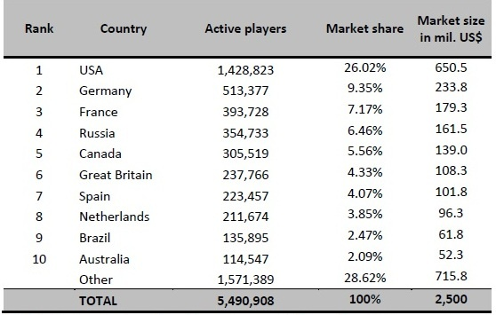
Target Customer
Target customers is anyone who has an interest in the game of Poker or an interest in Artificial Intelligence within Game Theory.
According to WPT it is estimated in 2011 that there where over 100 million online poker players in the world on a regular basis.

Slide 12
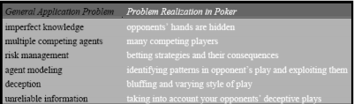
Problem Approach
The following table demonstrates why Poker is such an effective domain for Artificial Intelligence research.
Poker is a non-deterministic game. A player’s actions within the game can never guarantee the same outcome
Poker has stochastic outcomes. The element of chance through shuffling adds a great deal of variance to the results.
Hidden states in poker are partially observable. A player can win a pot uncontested, resulting in no private information being revealed.

Slide 13

Discussions
Opportunities and Limits
Develop in a still expanding area of Artificial Intelligence that hasn’t been solved yet.
No-Limit Hold’em card combinations
Requires 523 Terabytes of RAM to
to solve the game precisely.
Number of Atoms in the Universe = 10^80
Number of decision points in No-Limit Poker = 10^160

Slide 14
Goals
How will you solve the problem?
Develop an algorithm in which attempts to reach a Nash Equilibrium with the resources and computational power given.
What are you trying to achieve?
To create an Artificial Intelligence agent capable of good decision making and playing strong poker.

Slide 15
System
Description
A user should be able to register and login to an account
A user should be able to check their profile and the leaderboard
A user should be able to play poker vs an agent up to a human decision making level
Architecture
HTML & CSS
JavaScript
Java
MySQL
Main algorithms
Deck – Algorithm to shuffle the deck
Effective Hand Strength (EHS) – Calculate the immediate hand rank using an Enumeration technique
Hand – Get the number of cards in a hand
Player – The players actions (Bet, Raise, Call, Fold)

Slide 16
Design
Overview of the main requirements
Functional
Register a User
A User should be able to Login after Registering
User Profile setting – change password
User Leaderboard – Based on Chip count
Play Poker vs an AI Agent
Data
MySQL
System
Java

Slide 17
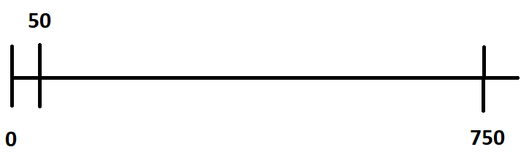
Evaluation
How will you evaluate the system?
mbb/g
What will be the results?
750 – Fold every hand
0 – Perfect play
0/50 – Professional Level

Slide 18
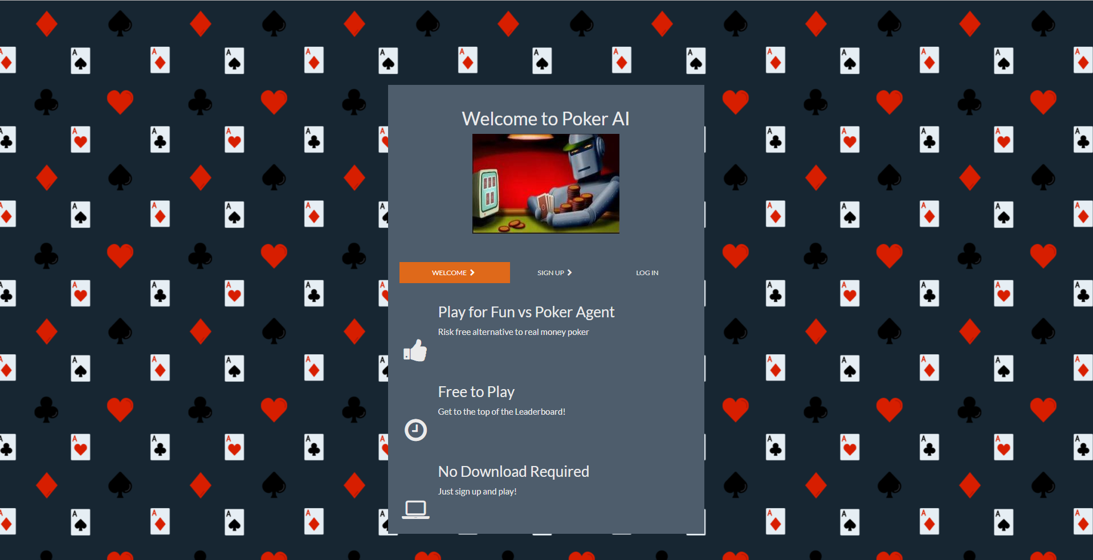
Demonstration

Slide 19
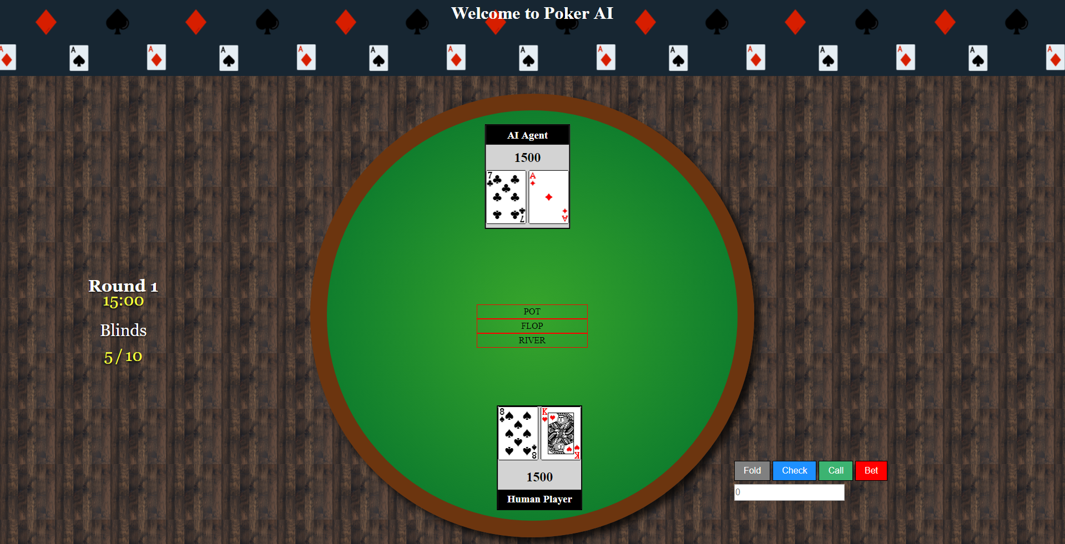
Demonstration

Slide 20
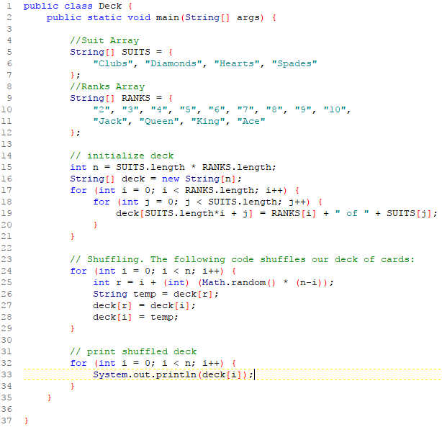
Demonstration

Slide 21
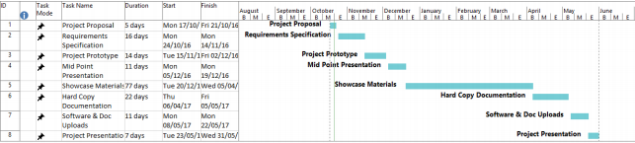
Going Forward
Project Plan

Slide 22

Discussion

